Slide 1
ECE 3436 Microprocessor Systems Notes 1: Introduction
Ph.D. Jianfeng Zheng
Dept. ECE, Univ. of Houston
Email: jzheng4@central.uh.edu
Jan 20, 2026
Adapted from notes by Dr. Diana De La Rosa-Pohl

Slide 2
Today’s agenda in ECE 3436
Objectives for the day
Why study Microprocessor Systems
Staff introduction
Calendar check
Announcements
Attendance
Prerequisite review
Academic honesty agreement
Syllabus review

Slide 3
Why Study Microprocessor Systems
People who are really serious about software should make their own hardware”
― Alan Kay & Steve Jobs
Microprocessor system is minimum computer and control system which needs both hardware and software knowledges
Microprocessor systems are widely used today, almost every where
Name three systems w/ and w/o microprocess/microcontroller
Think about impacts of Microprocessor systems
The power to make the world better
Good job opportunities

Slide 4
STAFF
Instructor
Dr. Jianfeng Zheng
Office:
ENGR BLDG 2, W316 (Office)
Teams (w/ camera)
Contact Info:
jzheng4@cougarnet.uh.edu
713-743-2849
Teams IM
Office Hours:
Tues/Thurs 2:00 pm – 3:00pm (W316)
Or virtual by appointment
Teaching Assistant
TBA
Grade the homework and quizzes
Help the students to complete the Lab projects

Slide 5
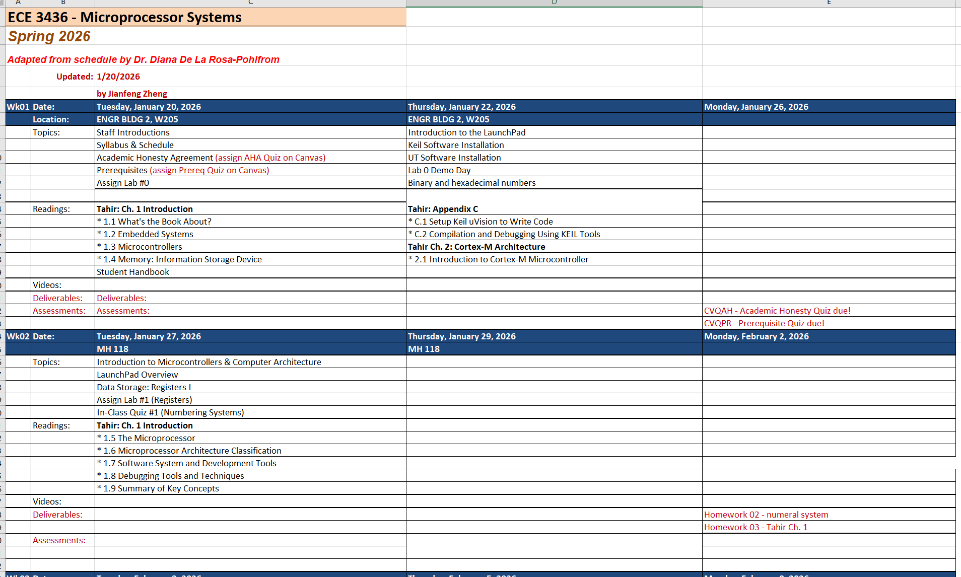
Calendar check
The schedule is tentative, will be adjusted and updated.
Always check schedule & Canvas for assignment due dates.

Slide 6
Announcements
All important announcements will be published thru Teams in the main channel. It is your responsibility to check this often.
Exams; Projects; Other issues
Important announcements will also be published on Canvas.
Exams; Due of Projects; Due of Homework
Sometimes emails will be sent to the class, make sure that your university email is working properly.
Email look like xxx@cougarnet.uh.edu

Slide 7
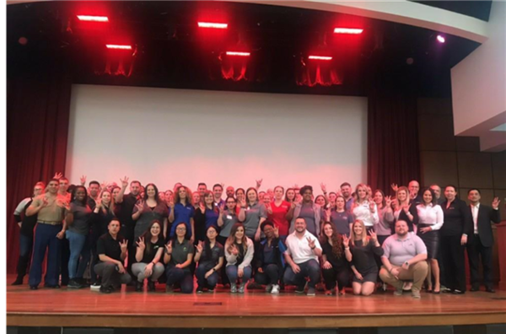
Announcements
STEM Career Fair:
Thursday, February 19, 2024
1:00 PM – 4:00 PM
Hosted in-person at the UH student center south – Houston room
STEM Career Fair - University of Houston (uh.edu)

Slide 8
Attendance
Class (or on-line) attendance is expected.
In class quizzes can be submitted thru canvas, with a grade weight of 90%.
Exams can’t be submitted w/ official excuses and approvals.
All the materials will be uploaded into Teams and/or Canvas.
To have an absence excused, you must get permission from the instructor before class begin
If you really want to take the class asynchronously, contact me.

Slide 9
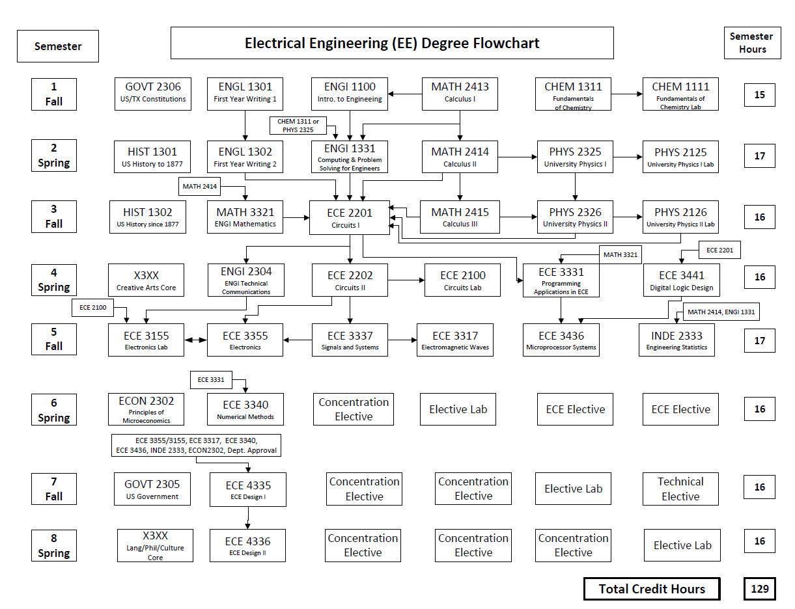
Prereq. Review
We are here

Slide 10
ECE 3436 Prerequisites
Credit for BOTH
ECE 3441 Digital Logic Design
ECE 3331 Programming applications in ECE
Credit OR Concurrent
ECE 2100 Circuits Lab
Required quiz on Canvas!
1. coming tonight
2. Due: Jan 26th (Monday)

Slide 11
Academic honesty agreement
Goto the UH web site
Academic Honesty Policy - University of Houston (uh.edu)
You can also find the link on Canvas
Read the policy
Required quiz on Canvas!
1. coming tonight
2. Due: Jan 26th (Monday)

Slide 12
Syllabus
Posted on Teams and/or Canvas
Make sure that you read Carefully
Schedule is also posted on Teams and/or Canvas
Must take AHA and Prereq quiz by deadline to remain in class
Check the due time in schedule

Slide 13

Textbooks
Required
ARM Microprocessor Systems, Muhammad Tahir & Kashif Javed, CRC Press
Optional:
Introduction to embedded system EE319K, Jonathan W. Valvano. (Amazon)
ChatGPT

Slide 14
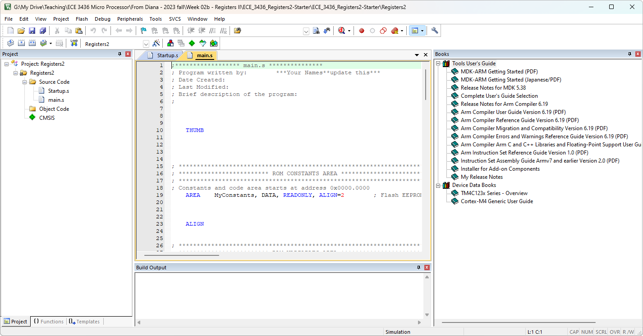
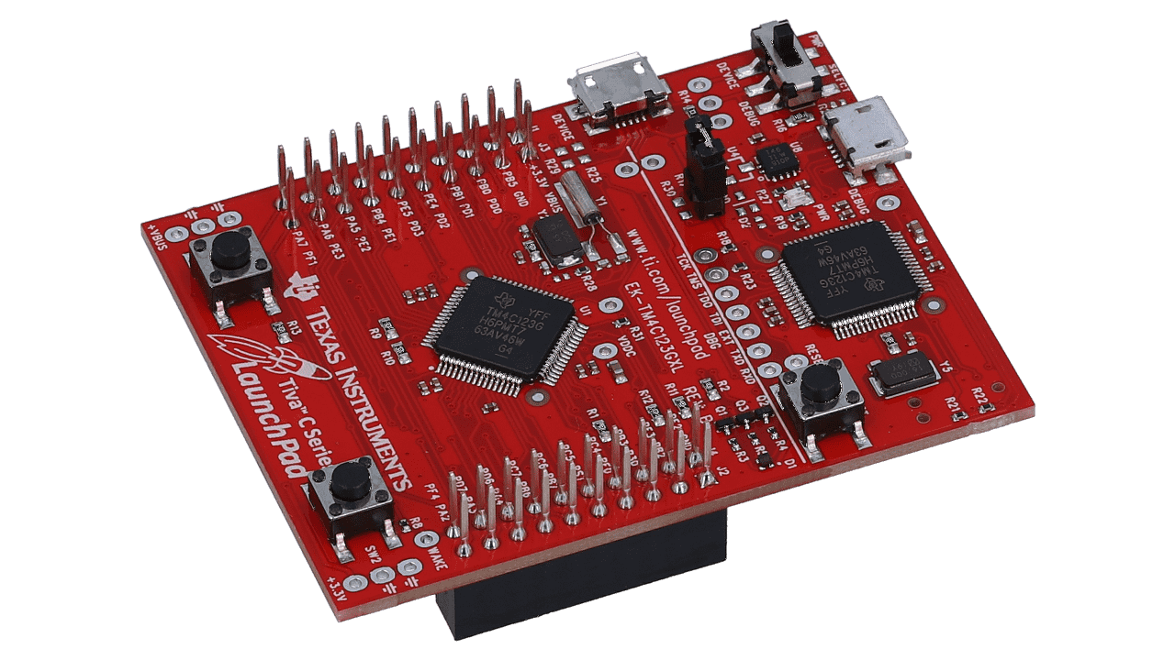
Platform
TI LauchPad
EK-TM4c123GXL
EK-TM4C123GXL Evaluation board | TI.com
Keil uVision
MDK-ARM Version 5.39 Evaluation Software Request (keil.com)

Slide 15
Labs
~6 projects
Good knowledge of digital logic theory is assumed
Teams of 2 (you can also choose to solo it)
Turn in via Canvas (Everyone in the team need to submit the codes)
10pts every day late

Slide 16
Grading (tentative)
Homework
Canvas/in-class quizzes
Projects/Labs
Exams
Final Exam optional
10% (equal weights, drop 1)
10% (equal weights, drop 1-2)
30% (equal weights, no drops!)
50% (3 times, no drops)
Comprehensive, replaces lowest exam
[90, 93): A‒; [93, +∞): A
[80, 83): B‒; [83, 87): B; [87, 90): B+;
[70, 73): C‒; [73, 77): C; [77, 80): C+;
[60, 63): D‒; [63, 67): D; [67, 70): D+;
below 60: F

Slide 17
Schedule overview
Refer to schedule posted on Teams and/or Canvas
Updates regularly, keep checking!
Some “lecture” materials will be up to the student to review outside of class
Significant parts of class time are reserved for hands-on demonstration & assistance if needed
Talk to me if you have any problems

Slide 18
Class Time
Everyone is expected to
Have their own LauchPad and other supplies
Have uVision installed on an available machine
Have access to basic equipment (will inform in advance if needed)
LEDs
Resistors
Multimeter

Slide 19
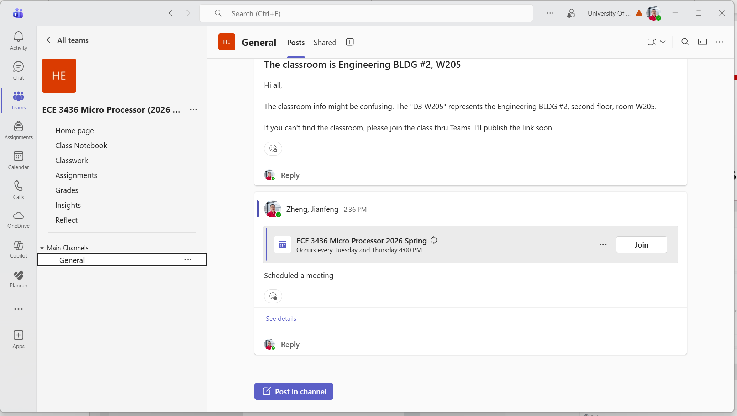
Teams and Canvas
Class Team
Access teams through Microsoft Teams
set your notifications to alert you to class posts
Most class information and announcements will be posted here first

Slide 20
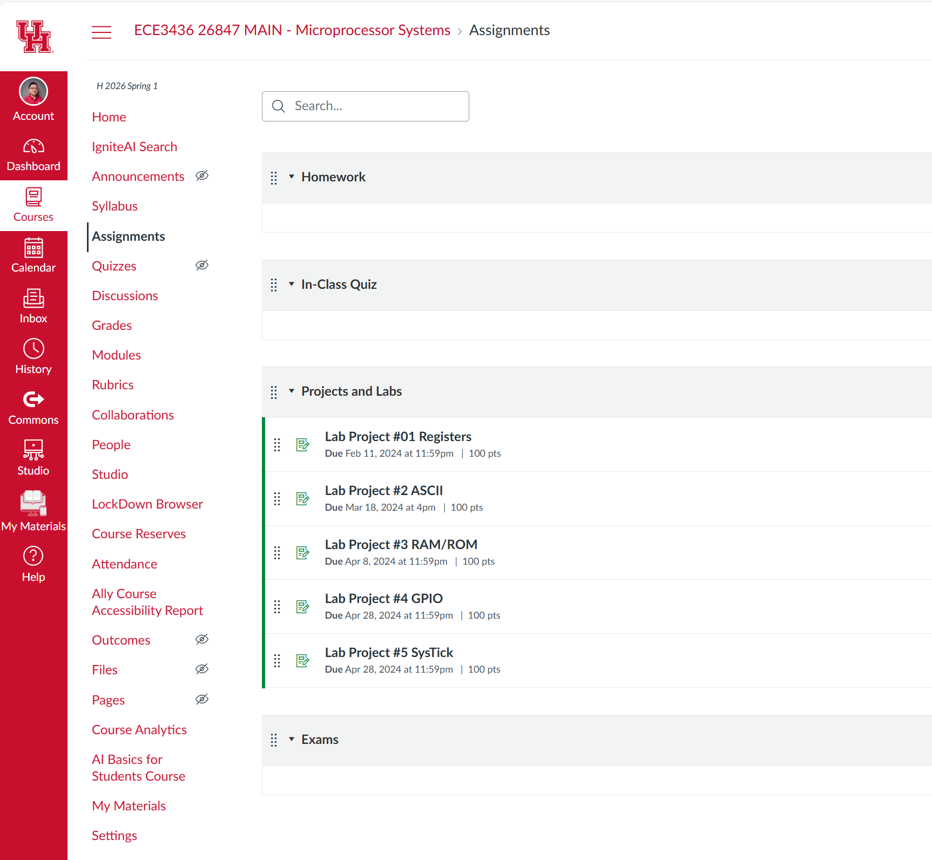
Teams and Canvas
Canvas
Labs
Homework
Online Quizzes/Exams
Grade Book
Notifications will also be posted here if possible.

Slide 21
ChatGPT/AI policy
is Allowed and Recommended to use
is NOT allowed to generate code and report directly
Consequences
You can NOT use computer/iPad in the Exams 2/3 and Final (still be open-book)
Randomly pick students to explain their codes if a computer is needed (Exam #1)

Slide 22
To-Do List
Buy Textbook
Buy LaunchPad (we can use the software simulator at beginning, you have some time)
Complete Prereq Quiz on Canvas
Complete AHA Quiz on Canvas
Install uVision & other software
Guidance coming soon.

Slide 23
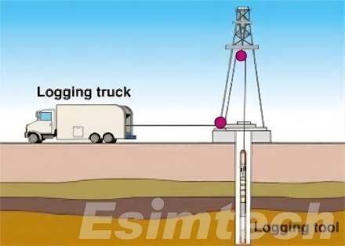
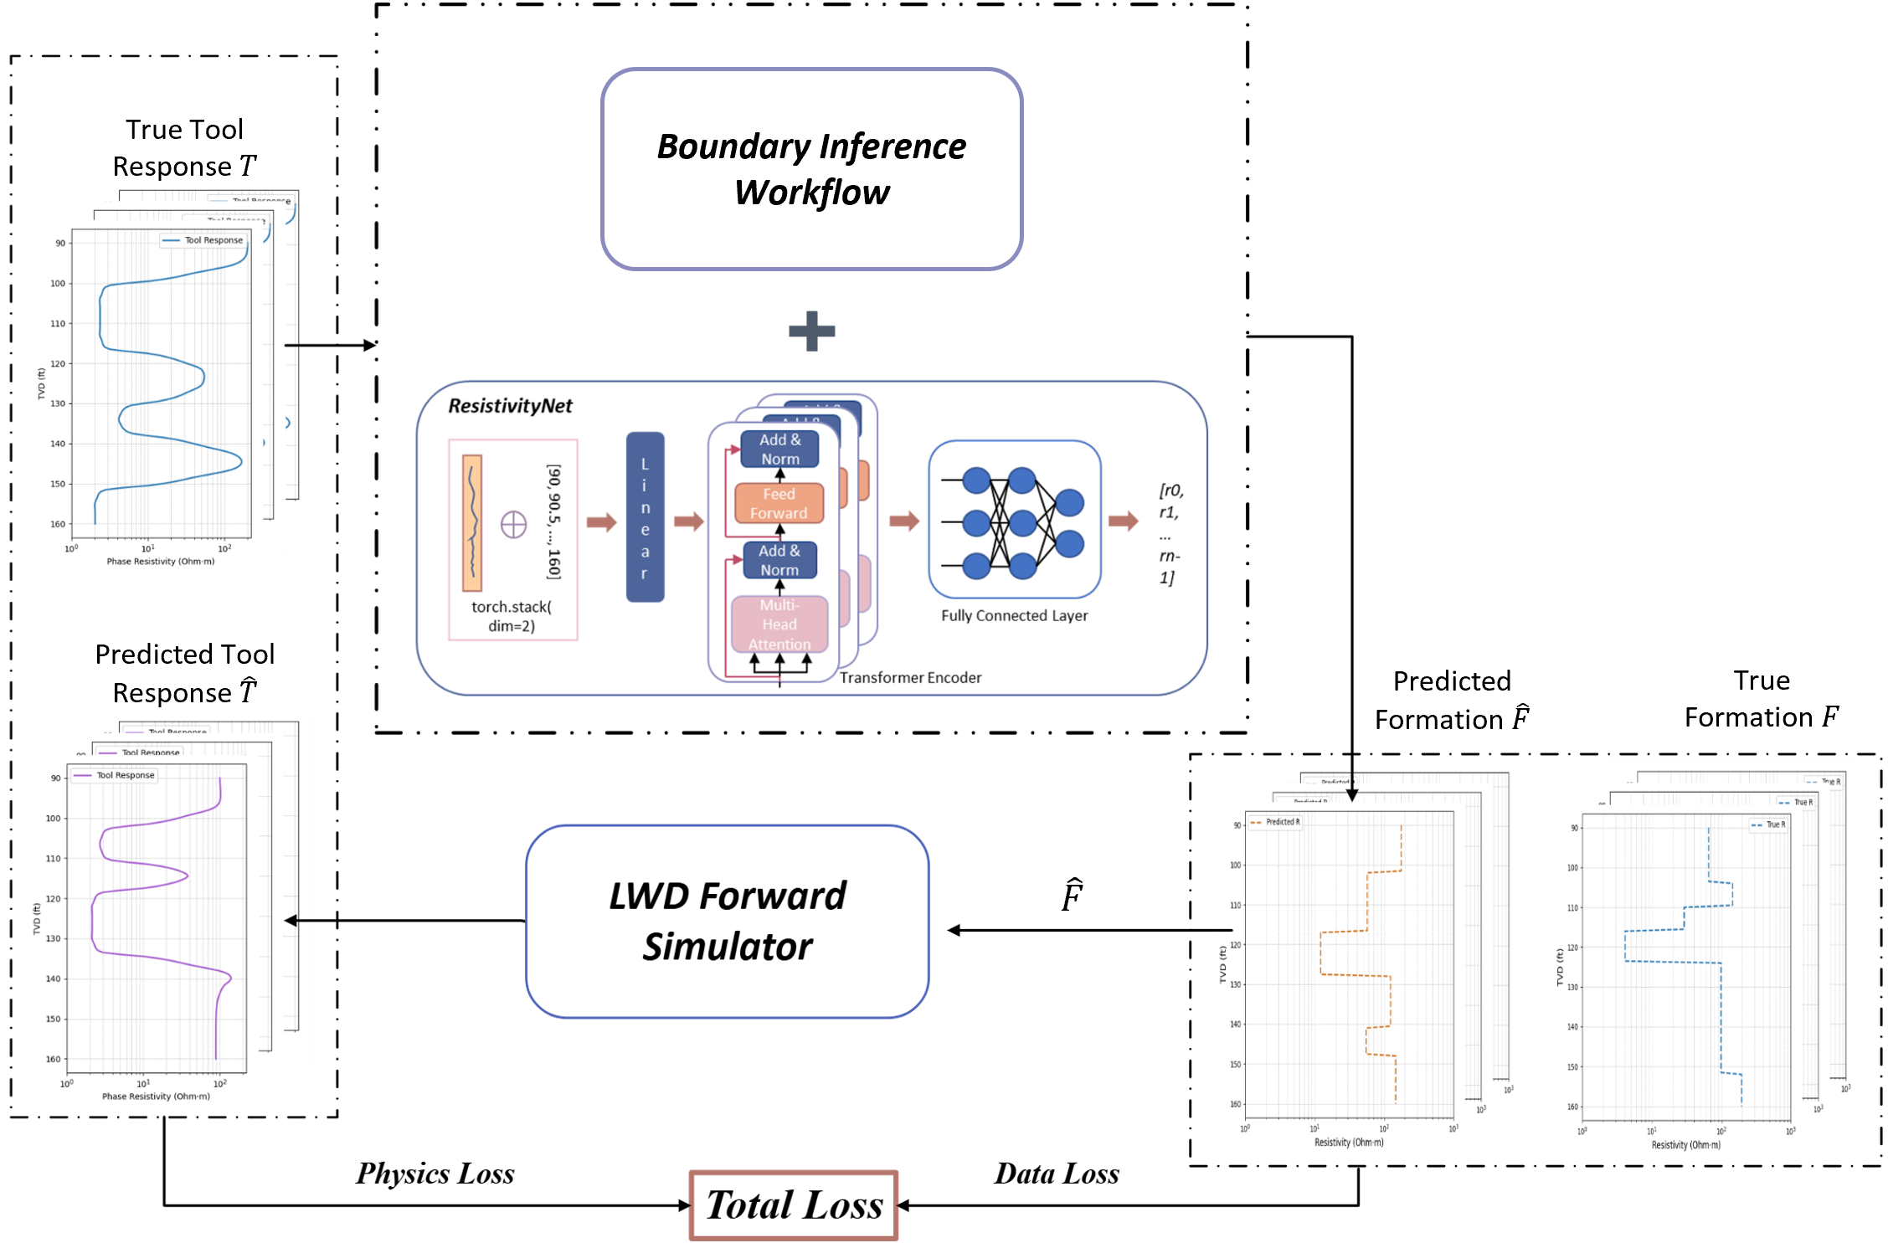
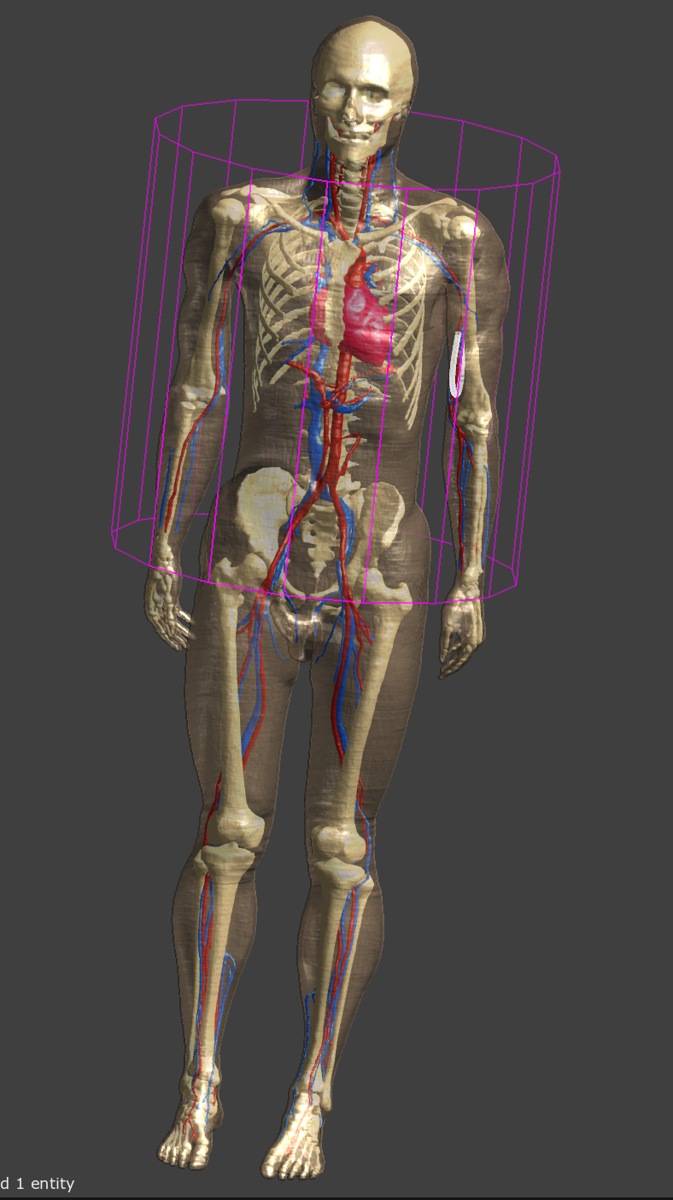
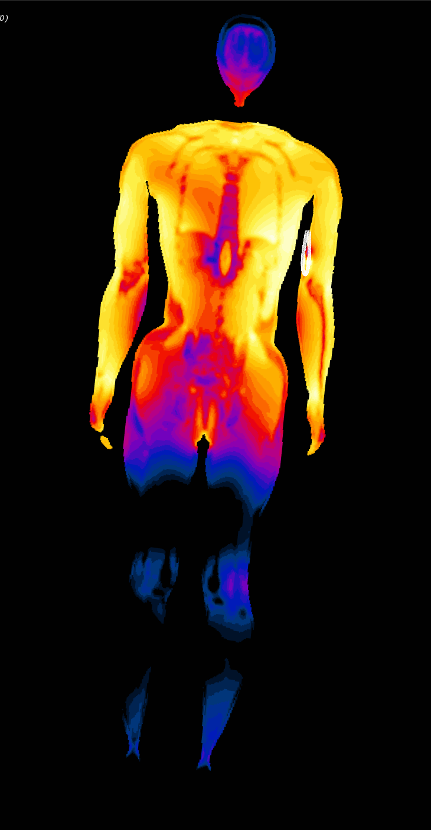
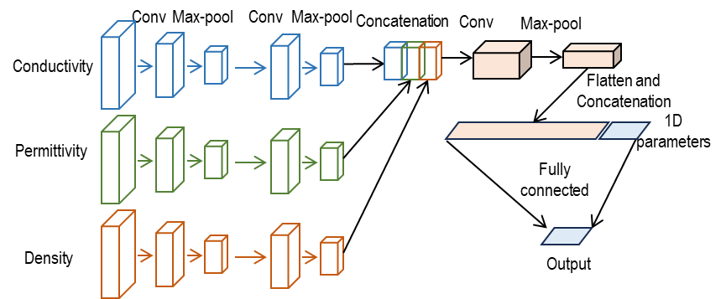
Research Interests
Well Logging
Applied EM
MR Safety
EM and AI

Slide 24
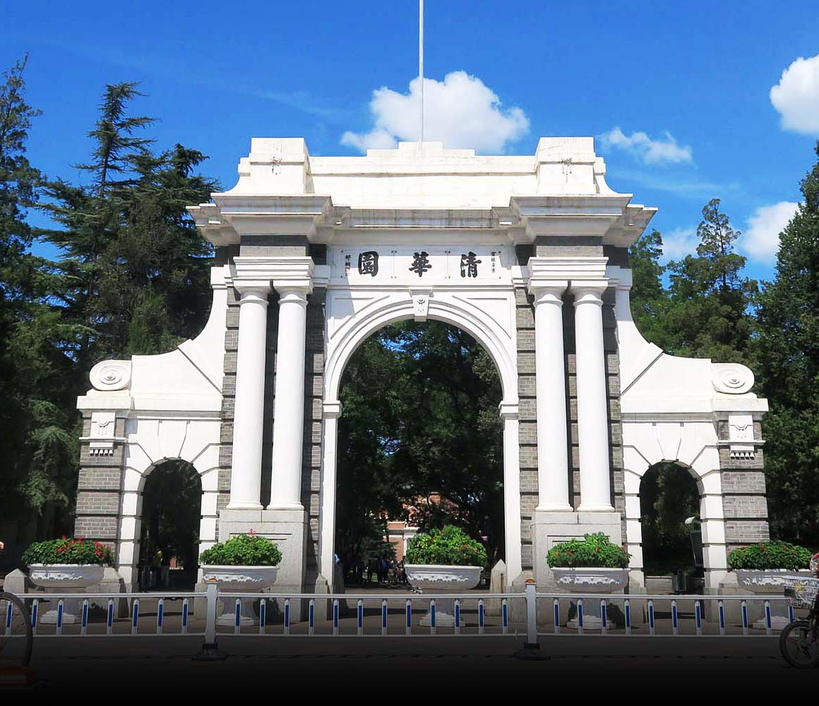
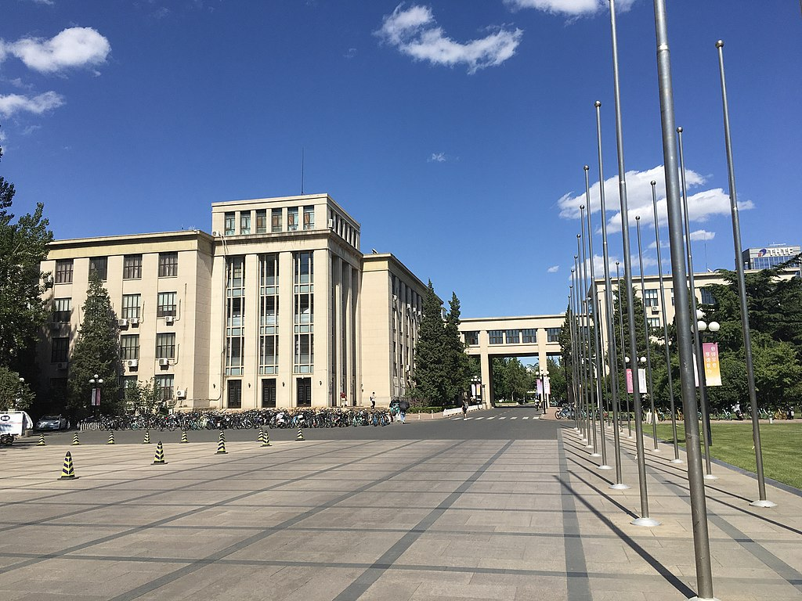
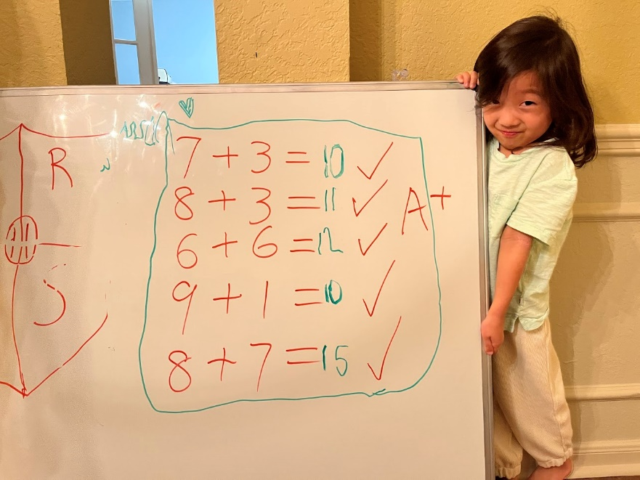
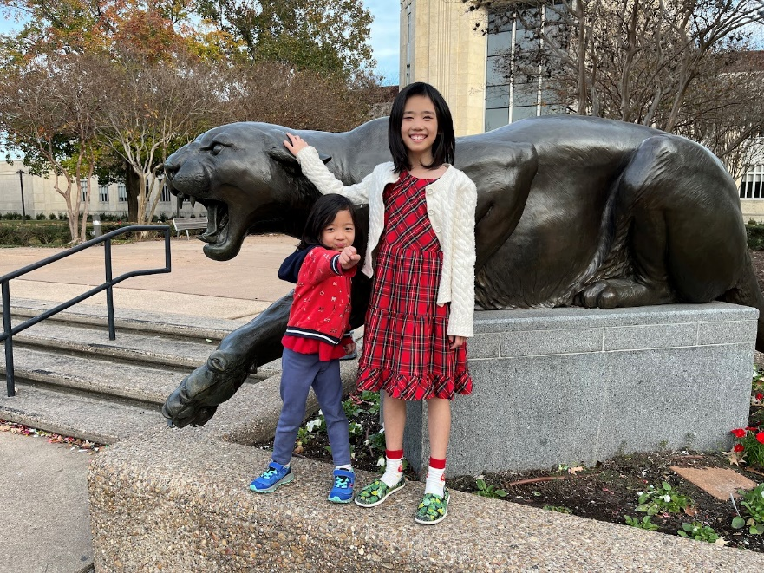
About Me
B.S. Electronic Engr – Tsinghua Univ
Ph.D. Electronic Engr – Tsinghua Univ
Background
Computational electromagnetics
Antenna and wireless propagation
Applied EM in biomedical engineering
Personal
Reading, tennis

Slide 25
Stay foolish, stay hungry
“If people never did silly things nothing intelligent would ever get done.” ― Ludwig Wittgenstein

